Slide 1
Species Observation System (SOS)
Martin Käck, SLU

Slide 2
Table of contents
Overview of SOS
Observation model
Vocabularies
API
IPT sync
DwC-A files
Web Feature Service
Access from GIS applications
Sensitive species observations
Sensitive species
Authorization
Grid aggregation
SWEREF99 TM grid cells

Slide 3
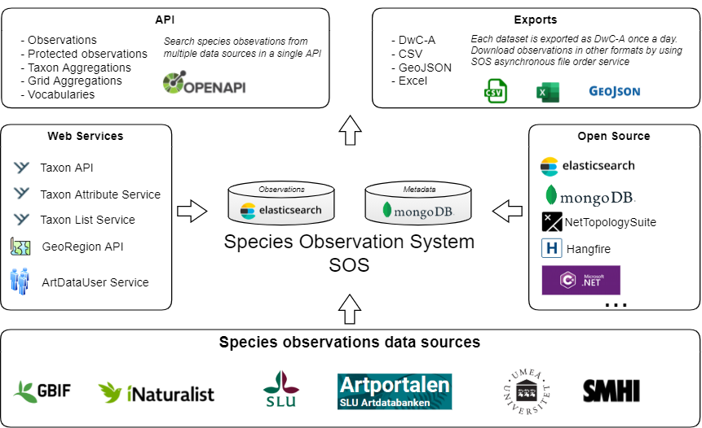
Overview of SOS
https://github.com/biodiversitydata-se/SOS
Notes:
Observation model – GitHub
Vocabularies – GitHub
Incremental harvest – Hangfire
API

Slide 4
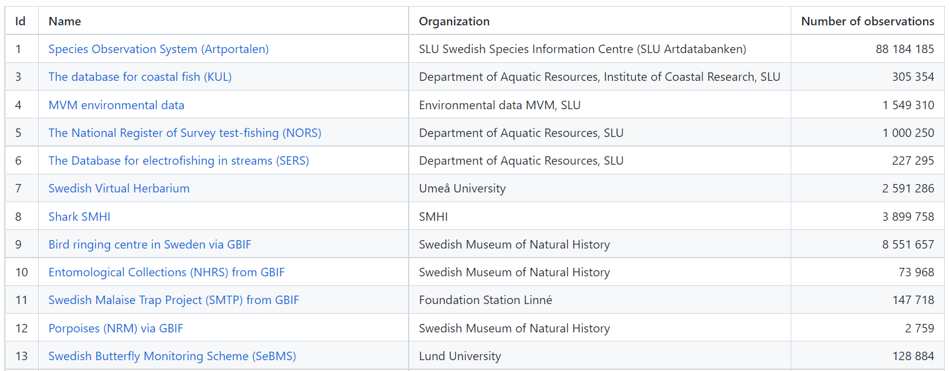
Overview of SOS
22 datasets
Notes:
Observation model – GitHub
Vocabularies – GitHub
Incremental harvest – Hangfire
API

Slide 5
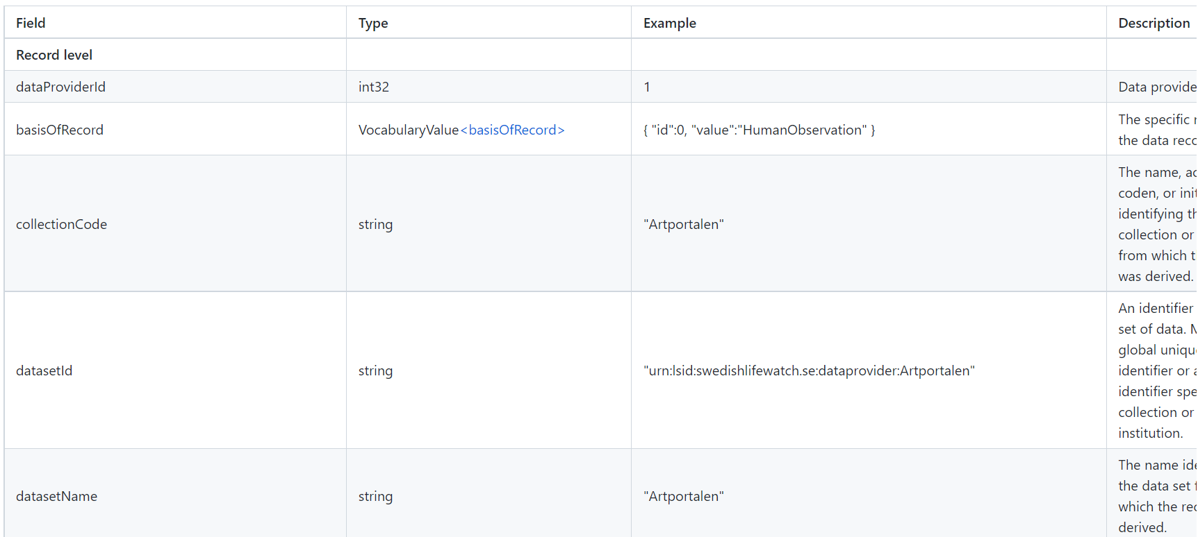
Overview of SOS
Observation model
Notes:
Observation model – GitHub
Vocabularies – GitHub
Incremental harvest – Hangfire
API

Slide 6
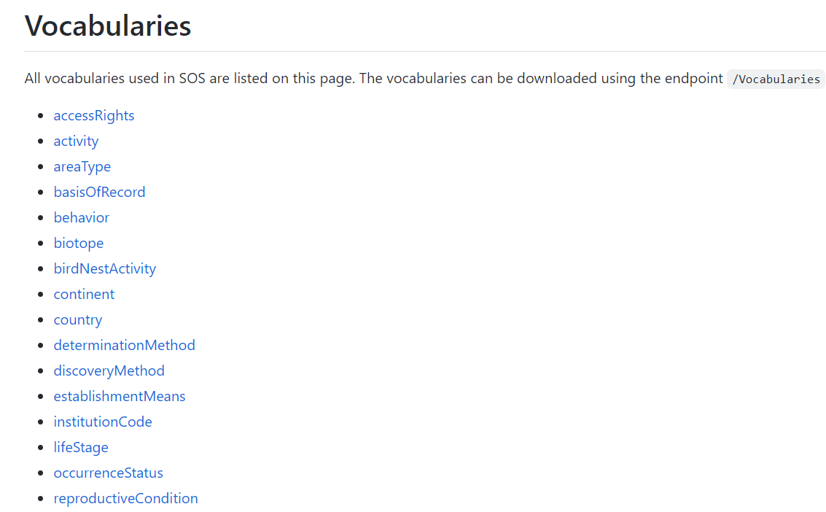
Overview of SOS
Notes:
Observation model – GitHub
Vocabularies – GitHub
Incremental harvest – Hangfire
API

Slide 7
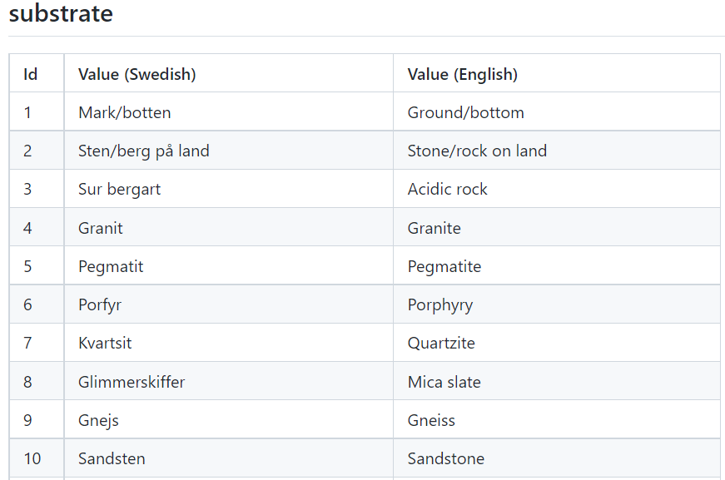
Overview of SOS
Notes:
Observation model – GitHub
Vocabularies – GitHub
Incremental harvest – Hangfire
API

Slide 8
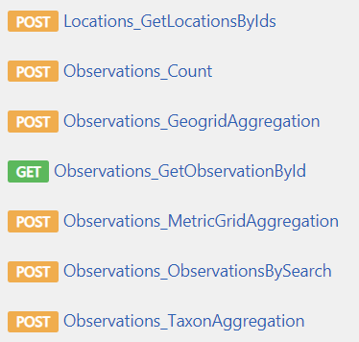
Overview of SOS
30 endpoints in the API
Notes:
Observation model – GitHub
Vocabularies – GitHub
Incremental harvest – Hangfire
API

Slide 9
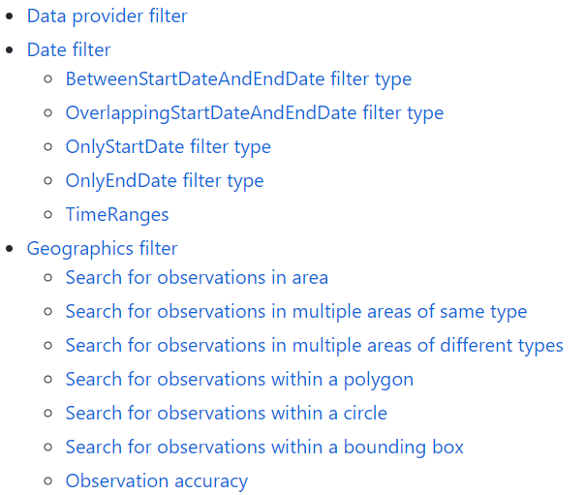
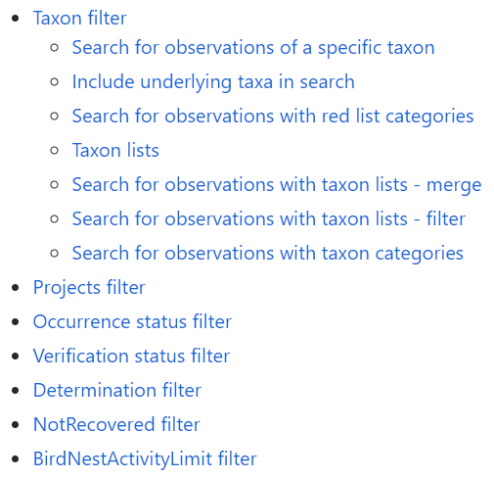
Overview of SOS
Search filters
Notes:
Observation model – GitHub
Vocabularies – GitHub
Incremental harvest – Hangfire
API

Slide 10
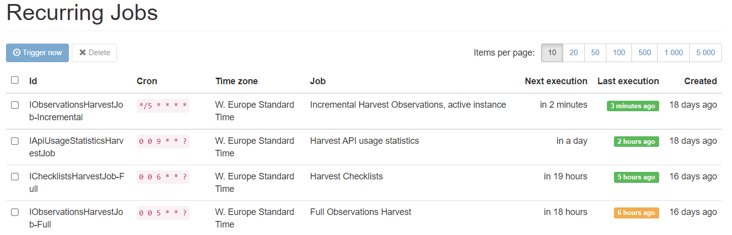
Overview of SOS
Job scheduling
Notes:
Observation model – GitHub
Vocabularies – GitHub
Incremental harvest – Hangfire
API

Slide 11
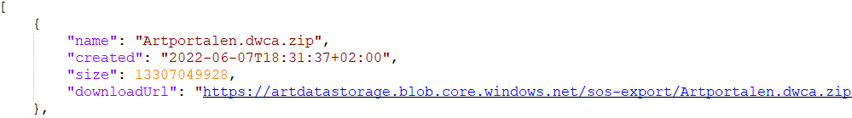
IPT sync
SOS creates a DwC-A file once a day for each dataset.
/Exports/Datasets API endpoint.
IPT
Harvest SLU datasets

Slide 12
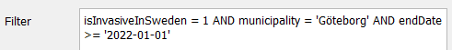
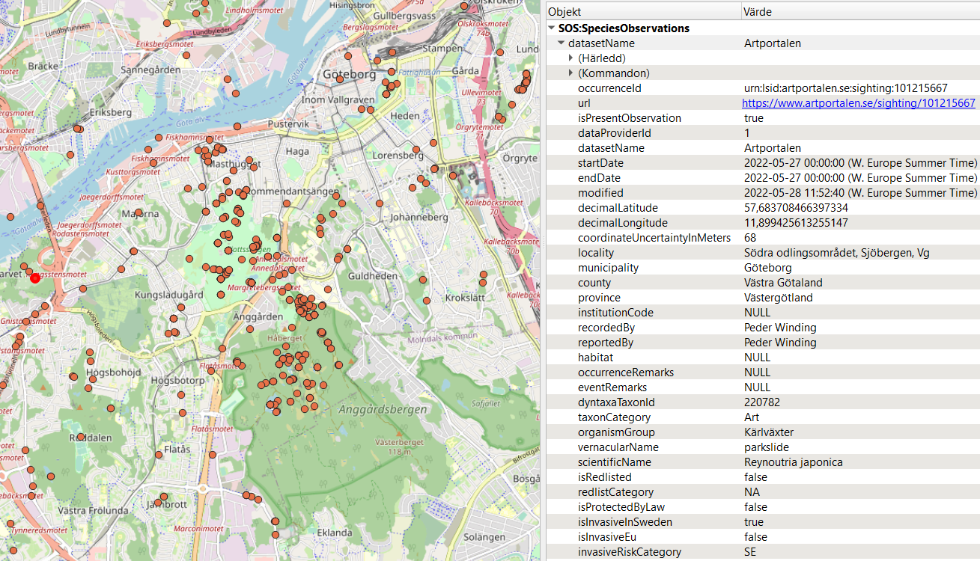
Web Feature Service (WFS)
Connected to SOS Elasticsearch database

Slide 13
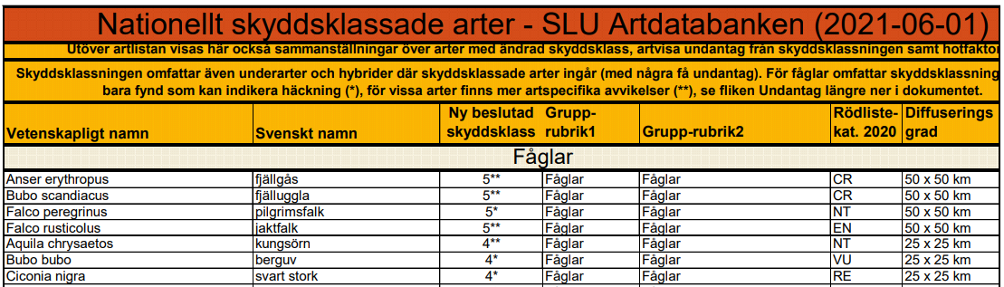
Sensitive species observations
Sensitive species in Sweden
https://www.gbif.se/ipt/resource?r=sensitivespecies
https://www.artdatabanken.se/var-verksamhet/fynddata/skyddsklassade-arter/

Slide 14
Sensitive species observations
Sensitivity categories
Sensitivity category | 1 | 2 | 3 | 4 | 5
Diffusion level | Public observations | Not used anymore | 5 x 5 km | 25 x 25 km | 50 x 50 km

Slide 15
Sensitive species observations
3 important properties for handling sensitive observations
Observation properties
Property | Example | Description
Sensitive | true | Indicates whether the observation is sensitive and therefore protected.
Occurrence.SensitivityCategory | 3 | Occurrence protection level. This is a value between 1 to 5. 1 indicates public access and 5 is the highest used security level.
Taxon.Attributes.SensitivityCategory | 3 | Taxon protection level. This is a value between 1 to 5. 1 indicates public access and 5 is the highest used security level.

Slide 16
Sensitive species observations
Sensitive birds are only protected certain times of the year.
Also depends on the geographical location.
Observation properties
Property | Example | Description
Sensitive | false | Indicates whether the observation is sensitive and therefore protected.
Occurrence.SensitivityCategory | 1 | Occurrence protection level. This is a value between 1 to 5. 1 indicates public access and 5 is the highest used security level.
Taxon.Attributes.SensitivityCategory | 4 | Taxon protection level. This is a value between 1 to 5. 1 indicates public access and 5 is the highest used security level.

Slide 17
Sensitive species observations
A user can choose to hide observations until a certain date.
Observation properties
Property | Example | Description
Sensitive | true | Indicates whether the observation is sensitive and therefore protected.
Occurrence.SensitivityCategory | 1 | Occurrence protection level. This is a value between 1 to 5. 1 indicates public access and 5 is the highest used security level.
Taxon.Attributes.SensitivityCategory | 1 | Taxon protection level. This is a value between 1 to 5. 1 indicates public access and 5 is the highest used security level.

Slide 18
Sensitive species observations
ArtdataUser database and API
> 50 000 users
Roles
Private person
Employed at Gothenburg municipality with access to sensitivity category 1-3.
Employed at Gothenburg municipality with access to sensitivity category 1-5.
…
Each role have one or more Authorities.
See observations (sensitivity category 1-3) in Gothenburg municipality.
See observations of a specific species in a specific area.

Slide 19
Sensitive species observations
Authentication
Oauth 2
ArtdataUser API
Authorization
Sensitive species observations are stored in separate index in Elasticsearch.
Based on the user role(s) and its authorities an Elasticsearch query will be generated.

Slide 20
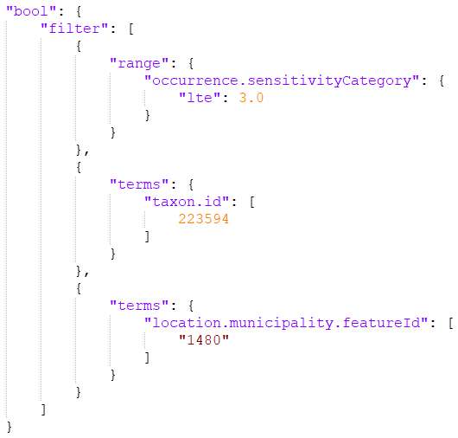
Sensitive species observations
Elasticsearch query
Access to sensitivityCategory 1-3 for the species with TaxonId 223594 in Gothenburg municipality

Slide 21
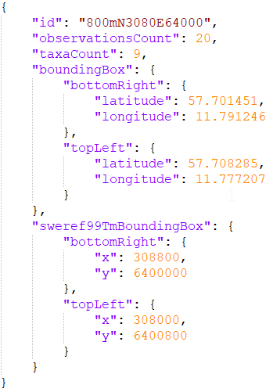
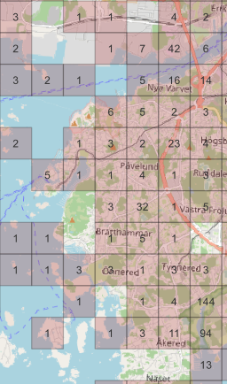
Grid aggregation
Create grid aggregation in SWEREF99 TM coordinate system.
/Observations/MetricGridAggregation?gridCellSizeInMeters=800.

